Slide 1

CIS 467 :Data Mining
Department of Information Systems
Faculty of Information Technology and Computer Sciences
Yarmouk University – Jordan
Prof. Dr. Qasem Al-Radaideh
© Qasem Al-Radaideh
Notes:
1

Slide 2
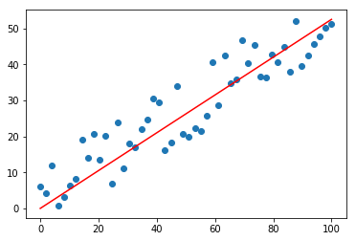
Topic 5
Prediction
(Regression)
Main Source: J. Han Book
Data Mining: Concepts and Techniques (2nd ed.)
(Chapter 6)

Slide 3
What Is Prediction?
“What if we would like to predict a continuous value, rather than a categorical label?”
Numeric prediction is the task of predicting continuous (or ordered) values for given input.
For example, we may wish to predict the salary of college graduates with 10 years of work experience, or the potential sales of a new product given its price.
(Numerical) prediction is similar to classification
Construct a model
Use model to predict continuous or ordered value for a given input
Prediction is different from classification
Classification refers to predict categorical class label
Prediction models continuous-valued functions
The most widely used approach for numeric prediction is regression.

Slide 4
Regression
Regression analysis can be used to model the relationship between one or more independent or predictor variables and a dependent or response variable (which is continuous-valued).
In the context of data mining, the predictor variables are the attributes of interest describing the tuple.
In general, the values of the predictor variables are known.
The response variable is what we want to predict—it is what we referred to as the predicted attribute (y).

Slide 5

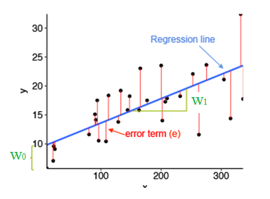

Linear Regression
Straight-line regression analysis involves a response variable (y), and a single predictor variable (x). It is the simplest form of egression, and models y as a linear function of x. That is,
where the variance of y is assumed to be constant, and b and w are regression coefficients specifying the Y-intercept (b) and slope of the line (w).
The regression coefficients, w and b, can also be thought of as weights, so that we can
equivalently write,

Slide 6
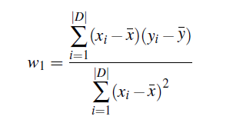

Regression Coefficients
These coefficients can be solved for by the method of least squares, which estimates the best-fitting straight line as the one that minimizes the error between the actual data and the estimate of the line.
Let D be a training set consisting of values of predictor variable, x, for some population and their associated values for response variable, y. The training set contains |D| data points of the form (x₁, y₁), (x₂, y₂), … , (x_{|D|}, y_{|D|}).
The regression coefficients can be estimated using this method with the following equations:

Slide 7
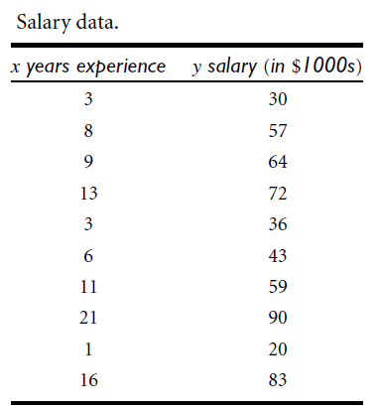
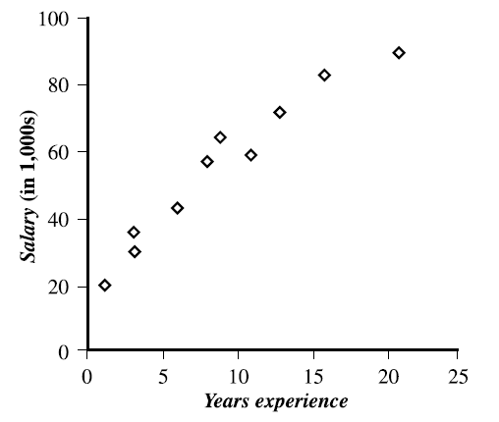
Example
The next Table (Training Dataset D) shows a set of paired data where x is the number of years of work experience of a college graduate and y is the corresponding salary of the graduate.

Slide 8

Solution
Given the previous data, we compute mean of x = 9.1 and mean of y = 55.4.
Substituting these values into the previous Equations, we get
Thus, the equation of the least squares line is estimated by:
Prediction Model
(Predictor)

Slide 9
Prediction Step
Now: Using the previous model (equation), we can predict that the salary of a college graduate with, say, 10 years of experience is $58,600.
Y = 23.6 + 3.5 * 10 = $58.600
Exercise: Using the previous model to predict the salary of a college graduate with 8 years of experience? What about 1 Year? What did you Notice?.

Slide 10
Predictor Evaluation
Predictor Error Measures
Principles:
Predictors return a continuous value rather than a categorical label, it is difficult to say exactly whether the predicted value is correct.
Measure predictor accuracy: measure how far off the predicted value is from the actual known value
Loss functions measure the error between yi and the predicted value, y’i. The most common loss functions are:

Slide 11
Predictor Error Measures
Loss function: measures the error between y_{i} and the predicted value y_{i}’
Absolute error (AE): | y_{i} – y_{i}’|
Squared error (SE): (y_{i} – y_{i}’)²
Test error (generalization error): the average loss over the test set
1) Mean absolute error: 2) Mean squared error:
3) Relative absolute error: 4) Relative squared error:
The mean squared-error exaggerates the presence of outliers.
Popularly use (square) root mean-square error, similarly, root relative squared error.
In practice, the choice of error measure does not greatly affect prediction model selection.

Slide 12
Example
Absolute Error (AE) : |yi - yi’|
Squared Error (SE) : (yi - yi’)^2
Yi → is the actual Value.
Yi’→ is the predicted Value using F(x) function (i.e. y)
Yi | Yi’
10 | 13
6 | 8
15 | 10
5 | 9
2 | 1
AE | SE
|10-13|=3 | 3^2=9
|6-8|=2 | 2ˆ2=4
|15-10|=5 | 5^2=25
|5-9|=4 | 4^2=16
|2-1|=1 | 1^2=1
Sum = 15 | 55

Slide 13
Continue
Test error (rate), or generalization error, is the average loss over the test set.
Mean absolute error (MAE) =
Mean squared error (MSE) =
1) MAE = (3+2+5+4+1)/5 = 3
2) MSE = (9+4+25+16+1)/5 = 11
AE | SE
|10-13|=3 | 3^2=9
|6-8|=2 | 2ˆ2=4
|15-10|=5 | 5^2=25
|5-9|=4 | 4^2=16
|2-1|=1 | 1^2=1

Slide 14
Continue
Now:
Ῡ = ∑y_{i} / d = (10+6+15+5+2)/5 = 7.6
Yi | |Yi - Ῡ | | (yi - Ῡ )^2
10 | 2.4 | 5.76
6 | 1.6 | 2.56
15 | 7.4 | 54.76
5 | 2.6 | 6.76
2 | 5.6 | 31.36
RAE= 15/(2.4+1.6+7.4+2.6+5.6) = 0.77
RSE=55/(5.76+2.56+54.76+6.76+31.36) = 0.54

Slide 15
Tools
Several software packages exist to solve regression problems. Examples include
SAS (www.sas.com),
SPSS (www.spss.com), and
S-Plus (www.insightful.com).
Another useful resource is the book Numerical Recipes in C, by Press, Flannery, Teukolsky, andVetterling, and its associated source code.
Note: Since the terms “regression” and “numeric prediction” are used synonymously in statistics.

Slide 16
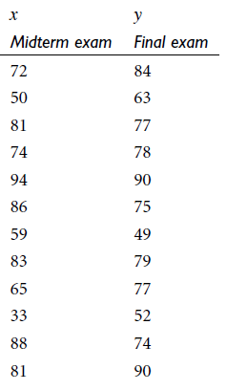
Home Work
The following table (Training Dataset D) shows the midterm and final exam grades obtained for students in a database course.
Plot the data. Do x and y seem to have a linear relationship?
Find an equation (F(x)) for the prediction of a student’s final exam grade based on the student’s midterm grade in the course.
Predict the final exam grade of a student who received an 86 on the midterm exam.
Find All error measures for the model F(X).
Use MS-Excel or SPSS to find the Model. Compare it with your model you found in (b).

Slide 17
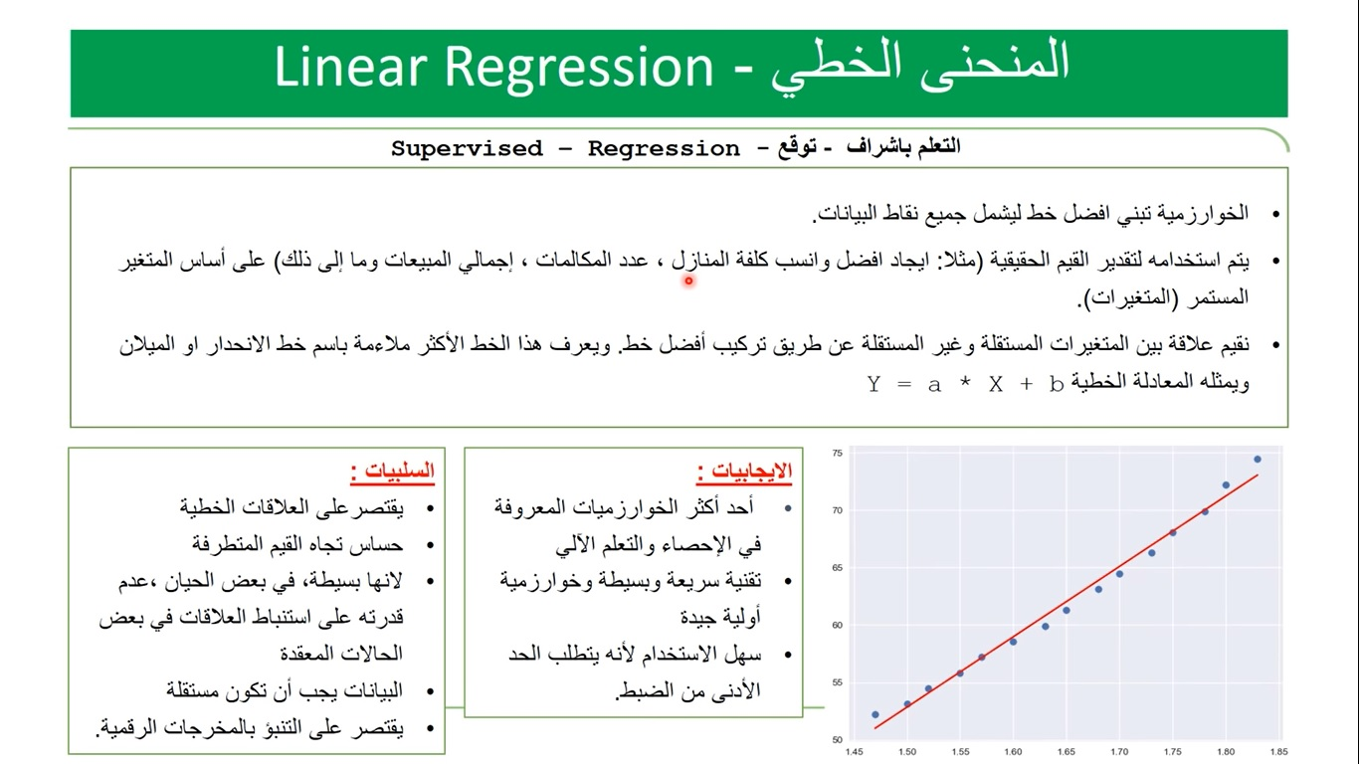
Linear Regression in Arabic

Slide 18
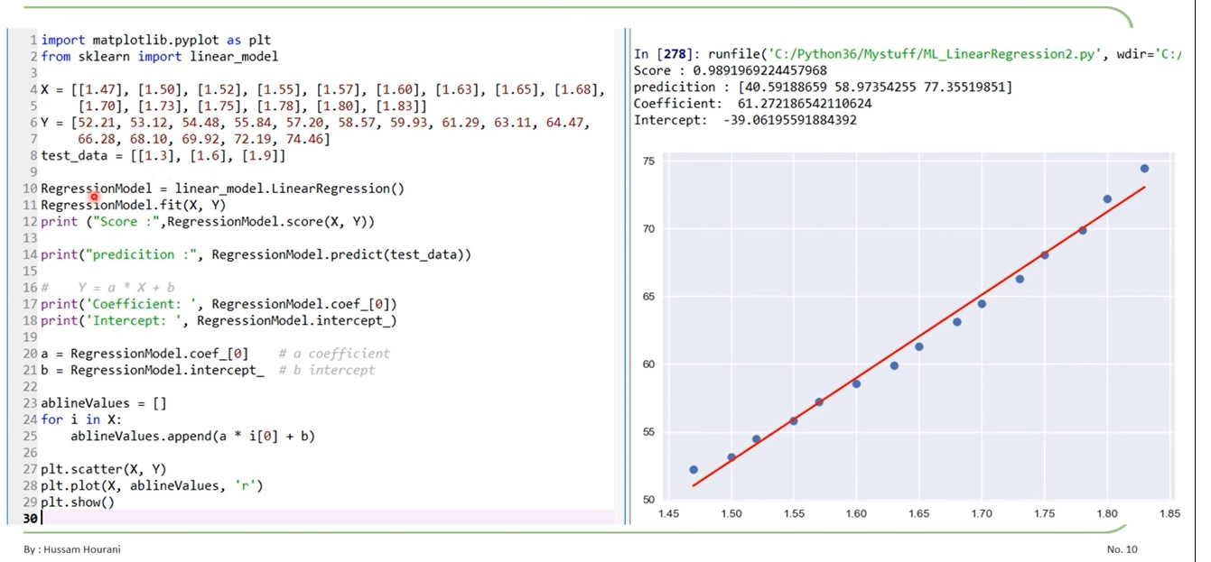
Linear Regression Using Python

Slide 19
Regression in WEKA
Watch this video
https://www.youtube.com/watch?v=9R0mz_gfhBs

Slide 20

Break

Slide 21


End … Thanks
Dr. Qasem Al-Radaideh
Yarmouk University

